Slide 1


ABI Summer 2021 Introduction to Statistics
Guest Session 2
Javier Cabrera*, Volha Tryputsen** & Davit Sargsyan**
July 7, 2021
(*)Rutgers, the State University of New Jersey
(**)Janssen Pharmaceutical Research and Development (J&J)

Slide 2


Know Your Tools
What are the research questions you are trying to answer?
What data do you need to answer them?
Can you design an experiment that will provide you with the data? Think about the experimental design long and hard!
What are the right tools, i.e., appropriate statistical techniques that can help you answer the questions?
Do you understand the statistical methods well enough to be confident with your inference? Things to consider:
Distributions
Missing data
Outliers

Slide 3

Research Questions
Ultimately, we are developing a drug that can cure or manage a disease
Is my drug better than the standard treatment or placebo?
Depending on a therapeutic area, these can be:
Can the drug reduce or eliminate cancer (oncology)
Can the drug reduce inflammation (immunology)
Can the drug help reduce weight, correct blood pressure, help damaged heart, regulate insulin (cardio-vascular and metabolism)
Can the drug eliminate harmful bacteria and viruses and prevent new infections (infectious diseases and vaccines)

Slide 4
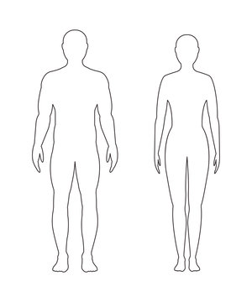
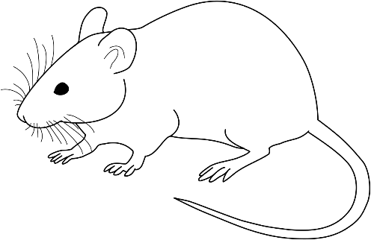
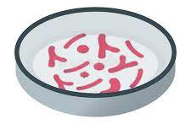

Animal Models in Drug Development
Before a drug is tested in humans, it needs to be tested in cells and animals
Cells, tissues or computer simulations are not complex enough (yet) to fully understand biological processes and interactions
Animal models are used to test compound toxicity, model PK/PD, understand drug-drug interactions, and many more

Slide 5
Know Your Tools
What are the research questions you are trying to answer?
What data do you need to answer them?
Can you design an experiment that will provide you with the data? Think about the experimental design long and hard!
What are the right tools, i.e., appropriate statistical techniques that can help you answer the questions?
Do you understand the statistical methods well enough to be confident with your inference? Things to consider:
Distributions
Missing data
Outliers

Slide 6


Study Endpoints
Endpoints that can be observed directly:
Survival rate and time
Tumor volume
Body weight change
Skin inflammation
Bacterial count
Biomarkers from blood or tissue
Protein concentration (Western blot, proteomics)
Gene expression (microarrays, qPCR, RNA- and DNA-seq, DNA methylation and acetylation)
Cell counting (flow cytometry)

Slide 7
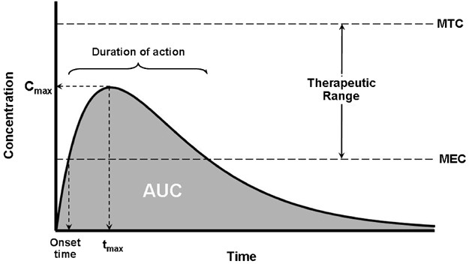
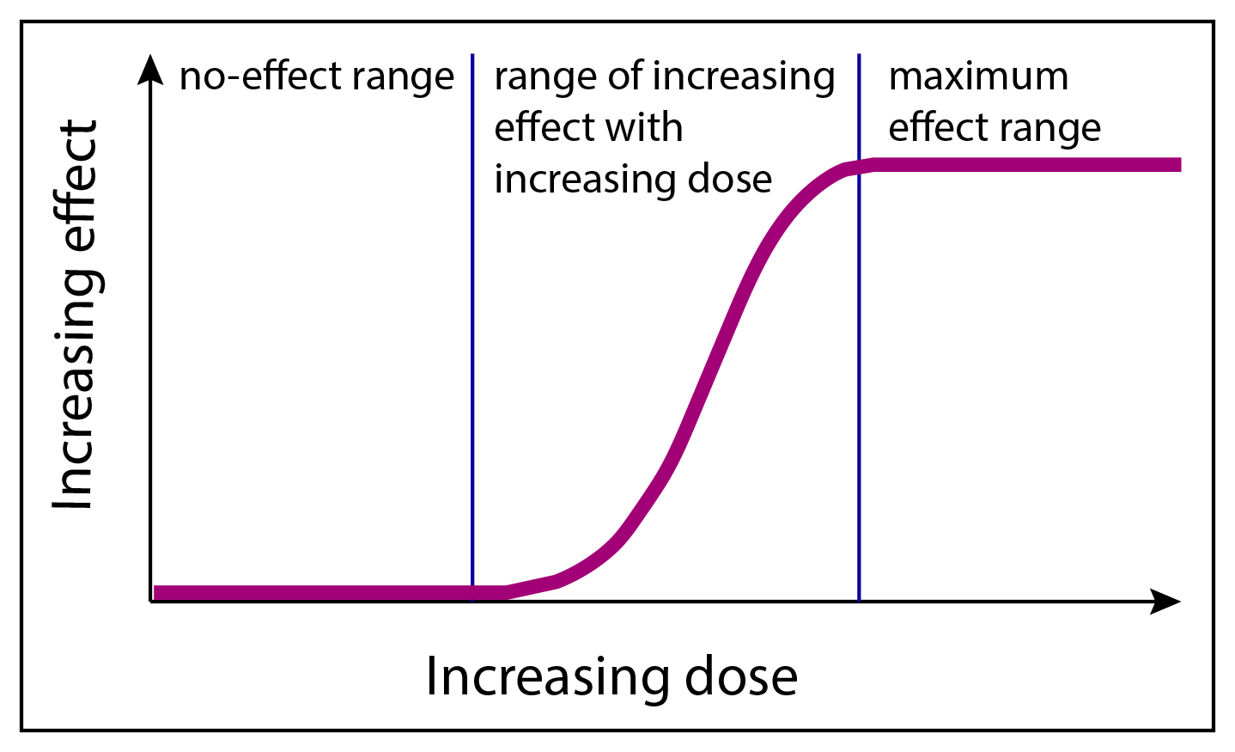
Pharmacokinetic/Pharmacodynamics (PK/PD)
Pharmacokinetic: what a body does to a drug
Drug concentration in blood or urine over time
Estimate large number of parameters: total drug exposure (AUC), distribution volume, drug elimination half-life, maximum concentration, renal clearance, etc.
Pharmacodynamics: what a drug does to a body
Estimate dose-response or exposure-response relationship
Calculate parameters: top and bottom asymptotes, slope, EC50/IC50, etc.

Slide 8
Know Your Tools
What are the research questions you are trying to answer?
What data do you need to answer them?
Can you design an experiment that will provide you with the data? Think about the experimental design long and hard!
What are the right tools, i.e., appropriate statistical techniques that can help you answer the questions?
Do you understand the statistical methods well enough to be confident with your inference? Things to consider:
Distributions
Missing data
Outliers

Slide 9




Basics of Animal Study Design
Is my drug working?
What is the range of values for my endpoints in healthy animals? Use naïve animals as controls (Group A)
Are they sufficiently different in sick animals? Use sick untreated animals as negative controls (Group B).
Can the drug prevent or reverse the effect of the disease? Use the drug in sick animals (treatment group, Group C)
Group A
Group B
Group C

Slide 10
Study Design Considerations
What questions do we need to answer with the study? The research hypotheses must be negatable!
What are the primary, i.e., the most important endpoints of the study?
What is the criteria for success? Minimum difference in primary endpoints that is biologically meaningful.
How much variability we expect? Use published data and previous experiments.
How many control and treatment groups do we need?
How many animals do we need that, given all of the above, we have a good chance to show statistically significant results?
What variables and experimental conditions can we control for?

Slide 11
Know Your Tools
What are the research questions you are trying to answer?
What data do you need to answer them?
Can you design an experiment that will provide you with the data? Think about the experimental design long and hard!
What are the right tools, i.e., appropriate statistical techniques that can help you answer the questions?
Do you understand the statistical methods well enough to be confident with your inference? Things to consider:
Distributions
Missing data
Outliers

Slide 12
Comparing groups
Group A: healthy
Group B: sick
Group C: treated sick

Slide 13




1. Comparing 2 groups
Group B: sick
Group C: treated sick

Slide 14
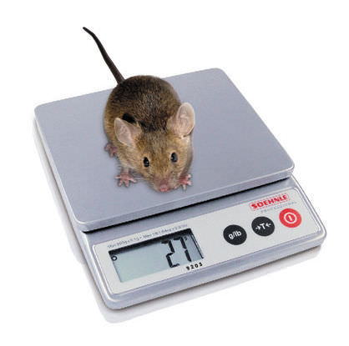
Mouse weight
Group B: sick
Group C: treated sick

Slide 15
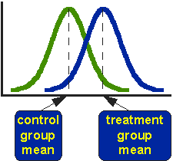
Weight distributions
Group B: sick
Group C: treated sick

Slide 16
Weight distribution`s center and spread
Spread: variance
Center: mean

Slide 17
Comparing 2 means
Question: Are mean weights in control are treated groups statistically different?

Slide 18
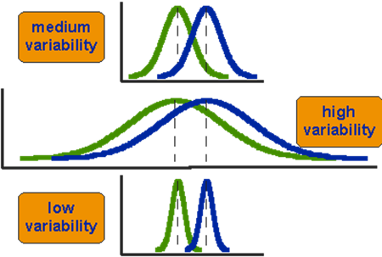
Difference between means - 3 scenarios
1. The difference between the means is the same in all three.
2. The two groups appear most different or distinct in the bottom or low-variability case.
3. When we are looking at the differences between weights for 2 groups, we must judge the difference between their means relative to variability!

Slide 19
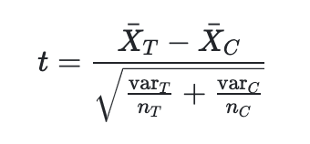
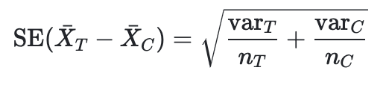
Comparing 2 Groups’ Means: t-Test
154330
=
=

Slide 20
Comparing 2 Groups’ Means: t-Test
=
=
Variance in treated and control groups
number of animals in treated and control groups

Slide 21
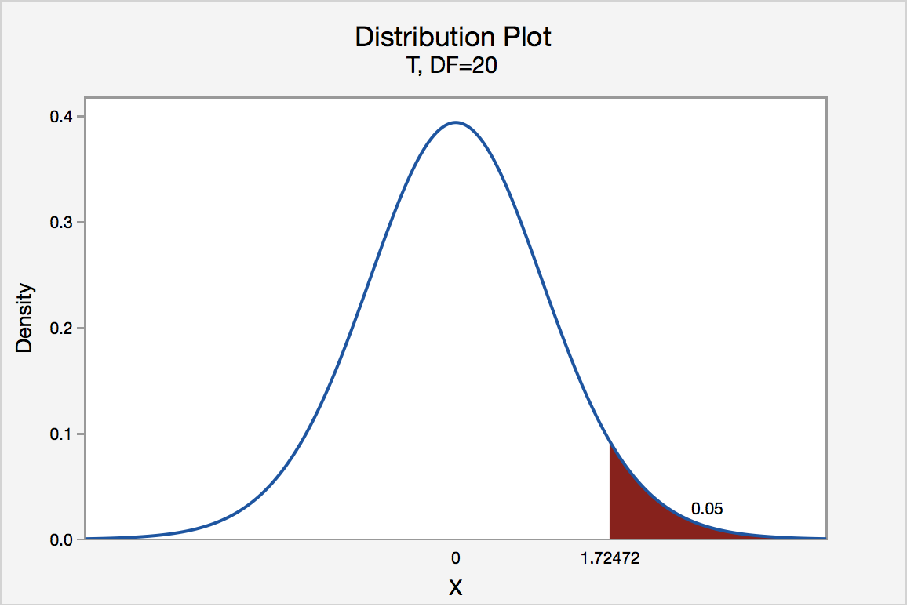
Comparing 2 Groups’ Means: t-Test
- Compute the t-value.
- To test the significance, you need to set a significant level alpha (usually alpha = 0.05). This means that 5% of time you would find a statistically significant difference between the means even if there was none (i.e., by “chance”).
- You also need to determine the degrees of freedom (df) for the test = the sum of the mice in both groups minus 2.
- Given the alpha level, the df, and the t-value, you can determine whether the t-value is large enough to be significant.
If it is, you can conclude that the difference between the means for the two groups is different.
t-value

Slide 22
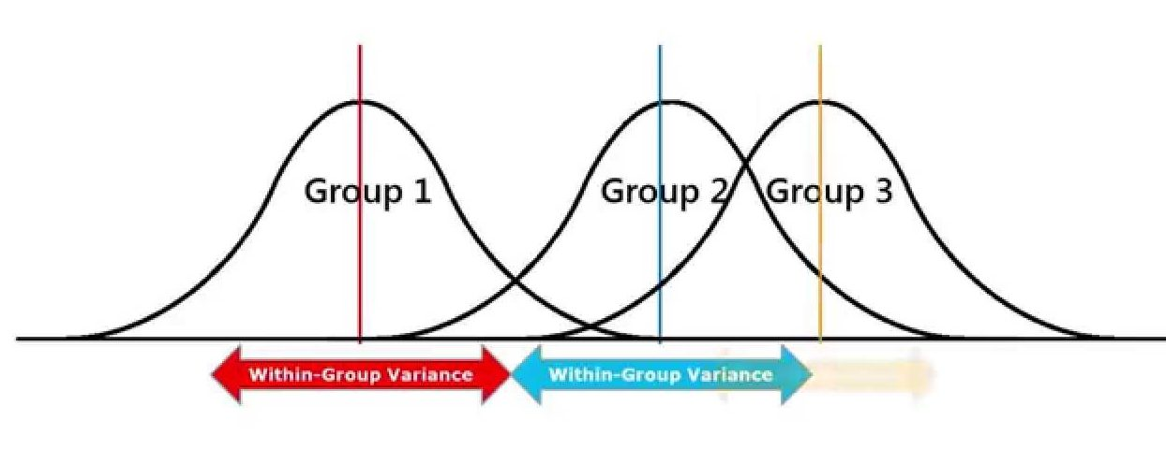
Comparing More Than 2 Groups’ Means with ANOVA
Group A: healthy
Group B: sick
Group C: treated sick
Null: All group means are equal.
Alternative: Not all group means are equal.

Slide 23
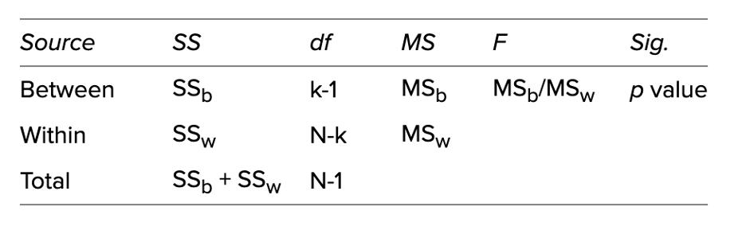
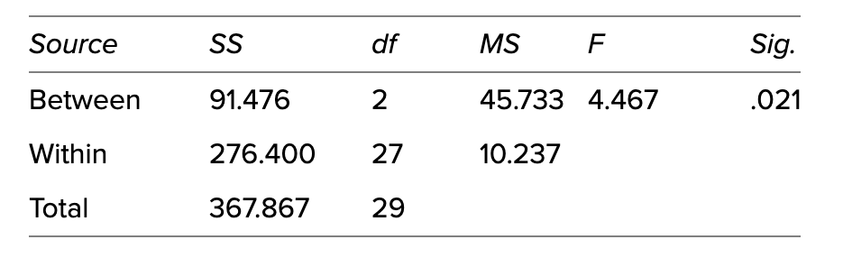
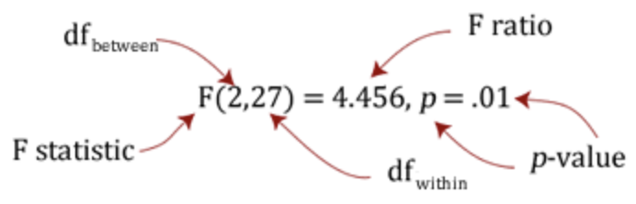
Comparing More Than 2 Groups’ Means with ANOVA

Slide 24
Comparing More Than 2 Groups’ Means with ANOVA and post hoc
The ANOVA test tells you whether you have an overall difference between your groups, but it does not tell you which specific groups differed – post hoc tests do.
Because post hoc tests are run to confirm where the differences occurred between groups, they should only be run when you have a shown an overall statistically significant difference in group means.
Post-hoc tests:
- Tukey's honestly significant difference (HSD) post hoc test - for all pair-wise comparison -
- Dunnett`s test – for all treatment to control comparisons

Slide 25
Group Assignment
Group 1 | Group 2 | Group 3 | Group 4 | Group 5
Gisane (R) | Arabo (R) | Susie (R) | Tamara (R) | Mher (R)
Arvin | Nerses | Ashkhen | Vardan | Vika
Satenik | Liana | Anush (R) | Hripsime | Nelli

Slide 26


The Royal Guinea Pig Problem
Once upon a time there were King and Queen
They had a favorite pet – Peppa the Guinea Pig
And life was great – until one day…
Source: https://www.123rf.com/photo_42732599_a-cartoon-queen-with-a-confused-expression-.html

Slide 27



The Royal Guinea Pig Problem
Once upon a time there were King and Queen
They had a favorite pet – Peppa the Guinea Pig
And life was great – until one day… Peppa became very ill

Slide 28

The Royal Guinea Pig Problem
Available resources:
Castle basement full of mice and rats
2 types of diet: regular grass or carrot-rich
3 natural compounds to use as treatments
The Guinea pig lost appetite and began losing weight . It even stopped eating its favorite treat - carrot
You are commissioned to find a cure for Peppa – and get half of the Kingdom
Or else…
Peppa’s Information
Age: 5 years 2 months; Sex: Female, Skin Color: Pink;
Favorite snack: carrots
 | Last Week | This Week
Diet | Grass and Carrots | Grass
Weight | 550g | 423g
Food Intake | 128g/day | 105g/day

Slide 29
Now, Lets Design the Experiment!
Research Question(s):
Diagnose Peppa first! You noticed inflammation in the guts.
Does the treatment make a difference?
Is diet affecting weight?
Endpoints:
Body weight
Food intake
Activity
Define success:
Significant difference between sick and treated mice body weight
No significant body weight change from the baseline weight
Study design:
5 Treatment groups: Naïve, negative control (harsh chemical to make mice sick), 3 treatments (all sick animals). We will not consider combinations
Diet: grass only vs crass + carrots
Data analysis and visualization:
t-Test: Naïve vs. Negative control to see if the inflammation made the animals sick
ANOVA + pairwise comparison: what treatment9s) work?
Dot plots, histograms, boxplots
Reporting :
Explain your results clearly to a non-scientists (aka King and Queen)

Slide 30
Homework (Due Next Tuesday)
Clone our GitHub https://github.com/sargdavid/abi_statistics
Find the data file in the “data” folder
Visualize the data (dot plot, histogram, boxplot)
Data analysis (t-Test, ANOVA with pair-wise comparisons)
Report the results: what is the best treatment available, and how confident you are that it will work. Hint: take into account the patient’s preferences
Report limitations of your study

Slide 31
Questions

Slide 32
References
https://www.statlearning.com/

Slide 33
Topics in Statistics Level I

Slide 34
Topics in Statistics Level II

Slide 35
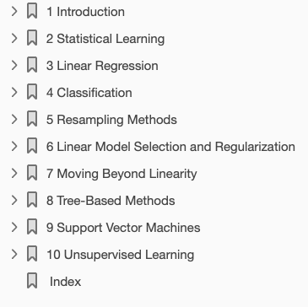
Topics in Statistics Level III

Slide 36
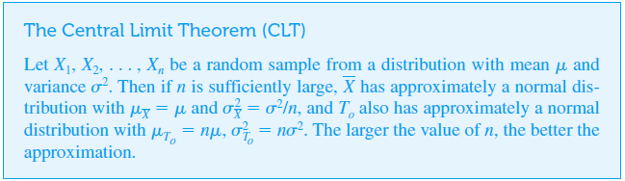
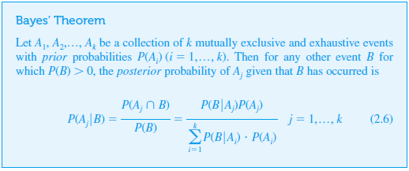
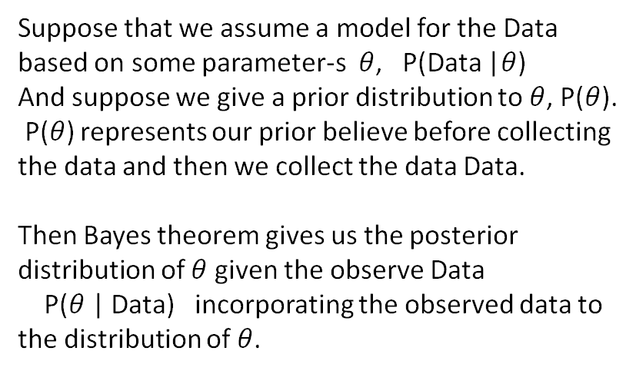
Probability: Central Limit Theorem and Bayes’ Theorem
If a statistic T is some linear combination of RV’s
Then for large samples T / SE(T) is approximately normally distributed regardless of the population of the data. This is the fundamental theorem of all statistics.
Suppose that we assume a model for the Data based on some parameter-s $θ$, P(Data |$θ$)
And suppose we give a prior distribution to $θ$, P($θ$).
P($θ$) represents our prior believe before collecting the data and then we collect the data Data.
Then Bayes theorem gives us the posterior distribution of $θ$given the observe Data
P($θ$ | Data) incorporating the observed data to the distribution of $θ$.

Slide 37
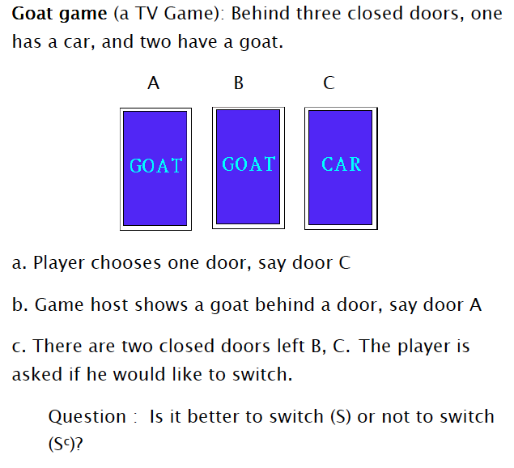
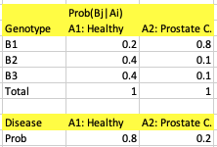
Probability homework
Q 1:
A is a disease : Prostate Cancer {A1, A2}
A1: Healthy A2: Prostate cancer
B is a genotype variable, it has 3 possible values {B1, B2, B3}
The following tables give the conditional probabilities of A and of B|A
Q 2:
The Data: For each patient we measure the genotype either B1, B2 or B3.
Calculate the posterior distribution of A (prostate cancer) given a genotype Bj.

Slide 38
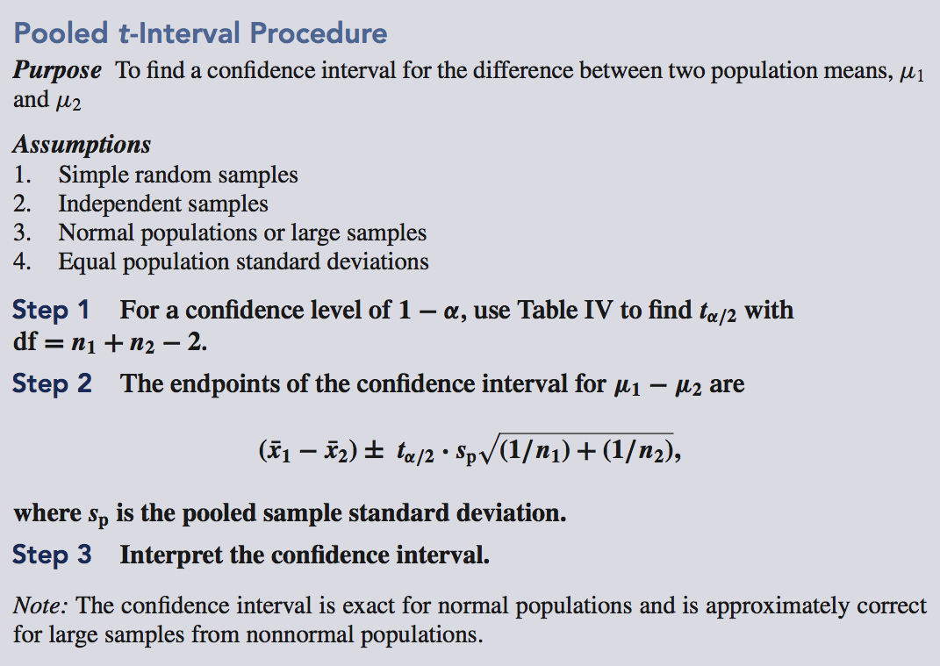
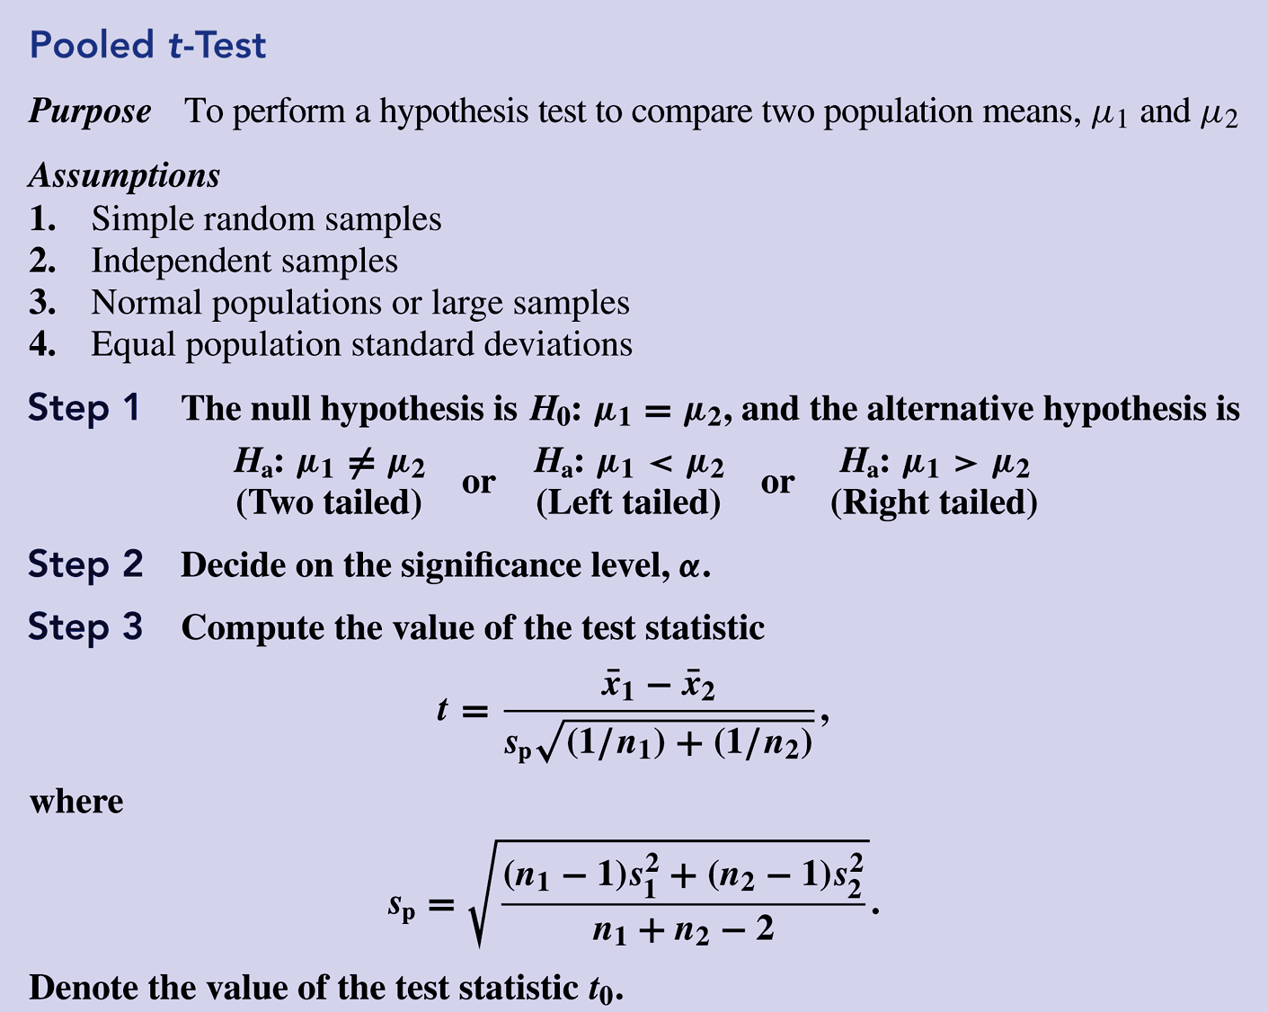
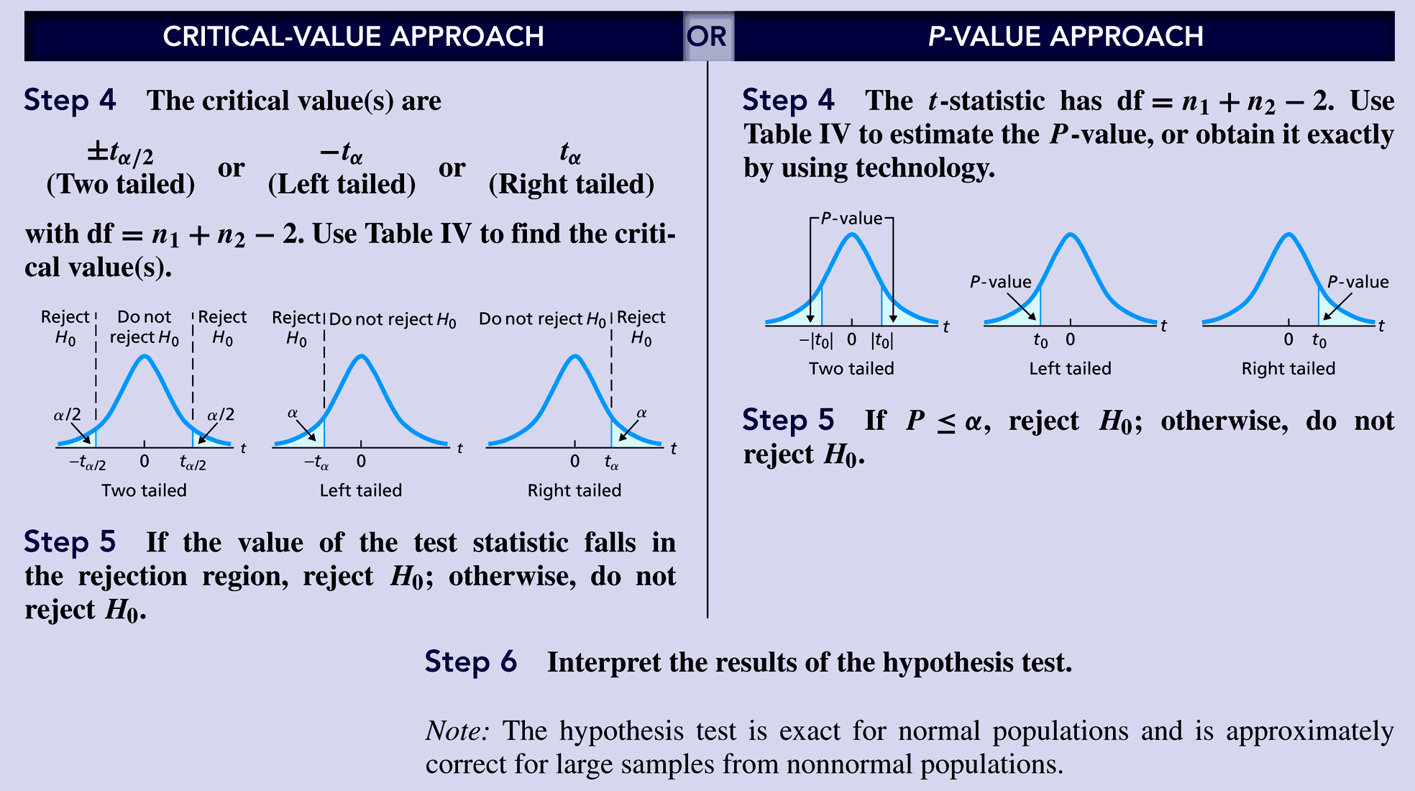
The Two-Sample t Test and t-Confidence Interval

Slide 39
Single-Factor ANOVA
The relevant hypotheses are
H₀: μ₁ = μ₂ = ··· = μI (POPULATION MEANS ARE EQUAL)
versus
H_{a}: at least two the of the μ_{i}’s are different
If I = 4, H₀ is true only if all four μ_{i}’s are identical. H_{a} would be true, for example, if μ₁ = μ₂ ≠ μ₃ = μ₄, if μ₁ = μ₃ = μ₄ ≠ μ₂, or if all four μ_{i}’s differ from one another.
Assumptions
Samples are independent
Populations are Normal
POPULATION VARIANCES ARE EQUAL

Slide 40
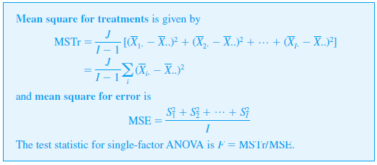
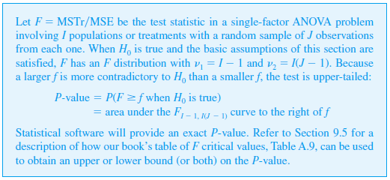
The Test Statistic
Theorem

Slide 41
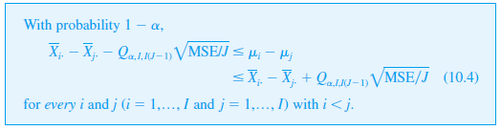
Multiple Comparisons in ANOVA
Several of the most frequently used procedures are based on the following central idea.
First calculate a confidence interval for each pairwise difference μ_{i} – μ_{j} with i < j. Thus if I = 4. the six required CIs would be for μ₁ – μ₂ (but not also for μ₂ – μ₁), μ₁ – μ₃, μ₁ – μ₄, μ₂ – μ₃, μ₂ – μ₄, and μ₃ – μ₄.
Then if the interval for μ₁ – μ₂ does not include 0, conclude that μ₁ and μ₂ differ significantly from one another; if the interval does include 0, the two μ’s are judged not significantly different.
Tukey’s Procedure (the T Method)

Slide 42
2^{p} Factorial Experiments
If an experimenter wishes to study simultaneously the effect of p different factors on a response variable and the factors have I₁, I₂,…, I_{p} levels, respectively, then a complete experiment requires at least I₁  I₂,  …  I_{p} observations. In such situations, the experimenter can often perform a “screening experiment” with each factor at only two levels to obtain preliminary information about factor effects. An experiment in which there are p factors, each at two levels, is referred to as a 2^{p} factorial experiment.
2³ Experiments
As in Section 11.3, we let X_{ijkl} and x_{ijkl} refer to the observation from the l th replication, with factors A, B, and C at levels i, j, and k, respectively. The model for this situation is
for i = 1, 2; j = 1, 2; k = 1, 2; l = 1, …, n. The ∈_{ijkl}’s are assumed independent, normally distributed, with mean 0 and variance σ ².
Because there are only two levels of each factor, the side conditions on the parameters of (11.14) that uniquely specify the model are simply stated: and the like. These conditions imply that there is only one functionally independent parameter of each type (for each main effect and interaction).

